Slide 1
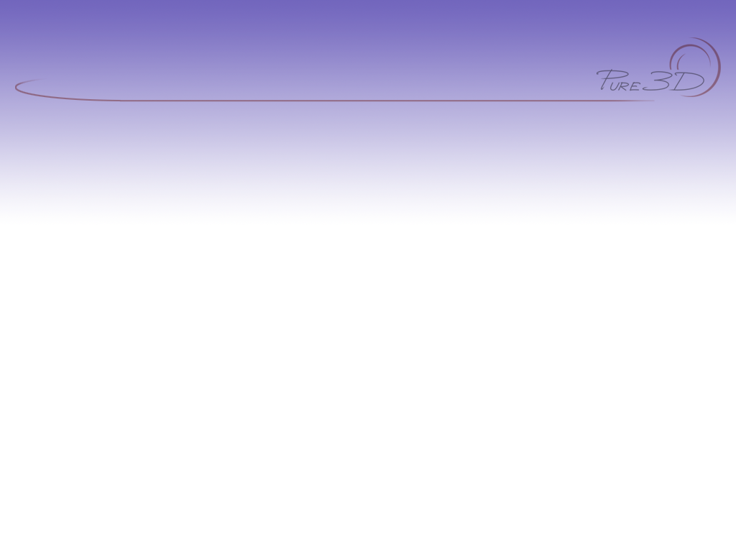
Maya MEL — Basics
Part 1
A Guide For Using MEL Effectively

Slide 2
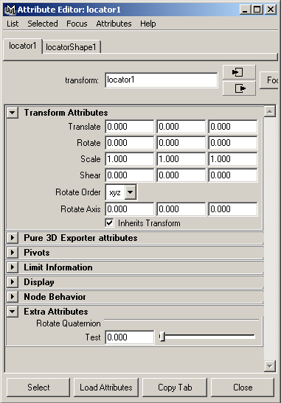
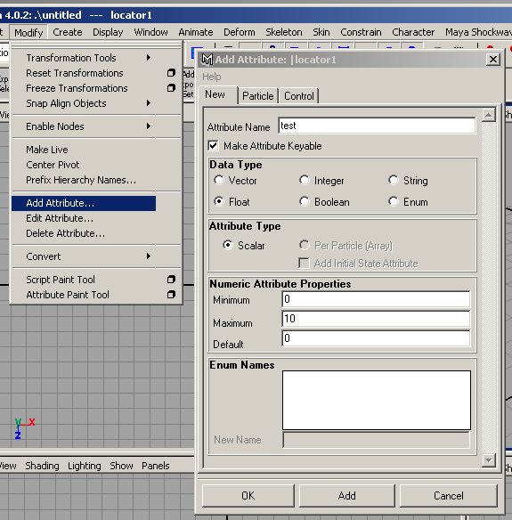

Add Attribute
Add sliders with no MEL required
End up in “Extra Attributes” in the Attribute Editor

Slide 3
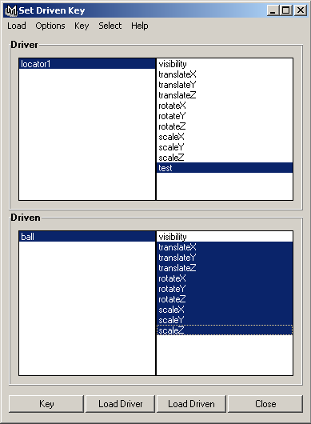
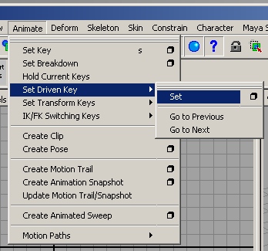
Driven Keys
Alternative to some expressions
Edited in the graph editor
Data driven and arbitrary
Limits are automatic

Slide 4
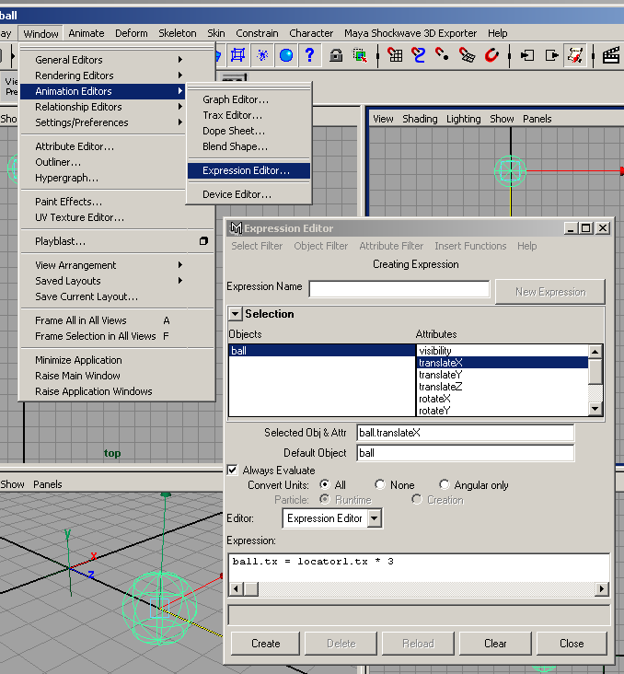
Expressions
Created in Expression Editor
Uses MEL syntax
Useful commands:
ball.ty = sin(time);
ball.ry = frame;
ball.sy = rand(5);

Slide 5
Randomness
(Demonstration)
expressions.ma
randomness.mb

Slide 6
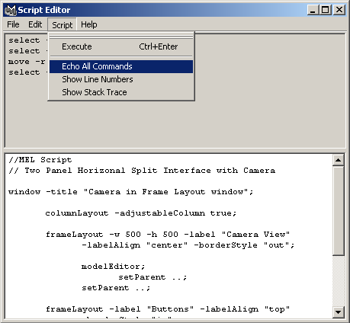

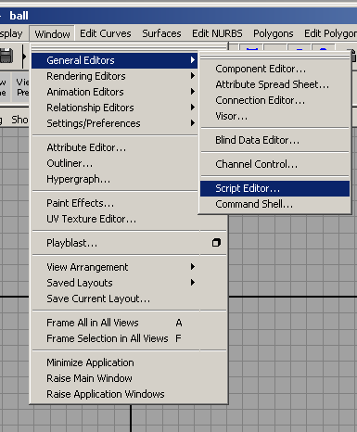
Drag'n'Drop
Can be used to generate macros with little programming knowledge.
Highlight and middle drag from the Script editor to the Shelf

Slide 7
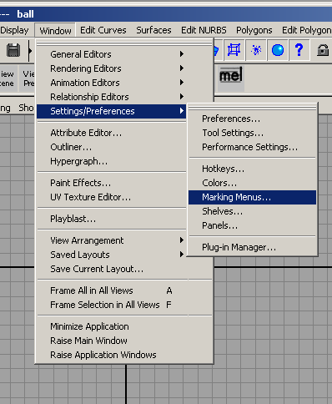
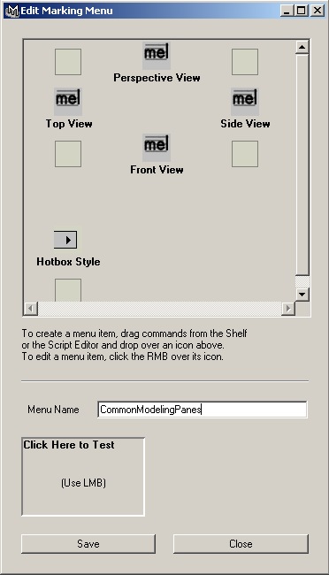
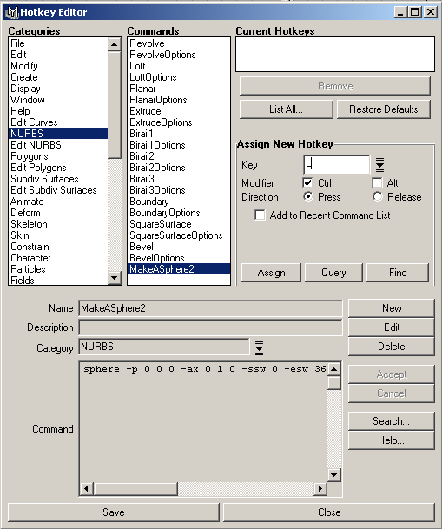
Maya Customization
Copy and paste MEL to Hotkeys and Marking Menus

Slide 8
Variables - Types
Different data = different storage type.
// Variables denoted by ‘$’
float $floatValue;
int $intValue;
string $stringValue;
Each type can represent an array.
string $stringArray[];
“Local” and “global” scope.
global int $globalInt;
  Beware of “global!”

Slide 9
Procedures
Reserve a keyword for a series of commands
Can use command line to execute
// MEL Script
// Define a simple procedure
global proc hereWeGo() {
float $EndSweep = 360;
sphere -p 0 0 0 -ax 0 1 0 -ssw 0 -esw $EndSweep -r 1;
}

Slide 10
Local vs Global
proc doSomething() {}
global proc performAction() {}
Local procedure
  Executed within the local scope of the MEL script.
  Used for private functions within a script.
Global procedure
  Executed in Maya's global scope.
  Procedure name is reserved.
  MEL code is tokenized and cached in memory.
  All callbacks must be global.

Slide 11
Installing MEL Scripts
"I've downloaded a script from Highend3D. Now what do I do?"
Radical's standard installation location:
"C:\AW\Maya4.0\scripts\others\"
Command to invoke script is name of main global procedure.
  e.g. global proc getAllAttachedNodes()
  Name = getAllAttachedNodes.mel
  Command = getAllAttachedNodes

Slide 12
Eval and Source
Can build commands from strings with eval
Can Initialize commands and procedures in an external file with source.
Together can execute and initialize unknown files and paths.
string $McCoyUserPath = "T:/ArtServer/McCoy/Batch/McCoy_Batch_Source.mel";
eval ("source "+" \"" + $McCoyUserPath + "\" ");
string $McCoyUserPath = "T://Artserver/McCoy/";
McCoyStart($McCoyUserPath);

Slide 13

Creating Custom UIs
Window with Sliders:
attrFieldSliderGrp
// Creates a window with sliders:
// Scales the xyz of a node labelled "ball"
window;
columnLayout;
  attrFieldSliderGrp -min 0 -max 5 -at ball.sx;
  attrFieldSliderGrp -min 0 -max 5 -at ball.sy;
  attrFieldSliderGrp -min 0 -max 5 -at ball.sz;
showWindow;

Slide 14

Custom UI with buttons
Procedures can be attached to buttons in a custom UI
// Creates a UI with two buttons that each execute procedures
window -title "Test Window" -widthHeight 300 100;
rowColumnLayout;
button -label "Make a Sphere" -command ("MakeASphere");
button -label "Make a Cone" -command ("MakeACone");
showWindow;
// NOTE: Procedures must be ‘global’!
global proc MakeASphere() {
sphere -p 0 0 0 -ax 0 1 0 -ssw 0 -esw 360 -r 1;
}
global proc MakeACone() {
cone -p 0 0 0 -ax 0 1 0 -ssw 0 -esw 360 -r 1;
}

Slide 15
Menus
window -menuBar true ExampleWindow3;
menu -label "File" TestFileMenu;
menuItem -label "Sphere" -command ("MakeASphere");
menuItem -label "Cone" -command ("MakeACone");
menuItem -label "Quit" -command ("evalDeferred( \"deleteUI ExampleWindow3\" )");
menu -label "Edit" TestEditMenu;
menuItem -label "Cut";
menuItem -label "Copy";
menuItem -label "Paste";
menu -label "Options" TestOptionsMenu;
menuItem -label "Color" -subMenu true;
menuItem -label "Red";
menuItem -label "Green";
menuItem -label "Blue";
setParent -menu ..;
menuItem -label "Size" -subMenu true;
menuItem -label "Small";
menuItem -label "Medium";
menuItem -label "Large";
setParent -menu ..;
showWindow ExampleWindow3;
global proc MakeASphere() {
sphere -p 0 0 0 -ax 0 1 0 -ssw 0 -esw 360 -r 1 -d 3 -ut 0 -tol 0.01 -s 8 -nsp 4 -ch 1; objectMoveCommand;
}
global proc MakeACone() {
cone -p 0 0 0 -ax 0 1 0 -ssw 0 -esw 360 -r 1 -hr 2 -d 3 -ut 0 -tol 0 -s 8 -nsp 1 -ch 1; objectMoveCommand;
}

Slide 16
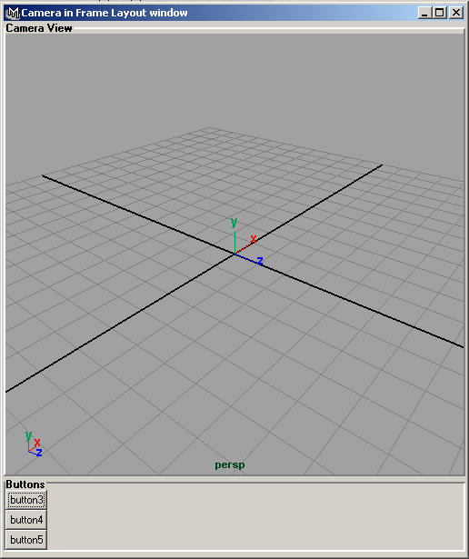
Frame Layout

Slide 17
Frame Layout (MEL)
// Two Panel Vertical Split Interface with Camera
window -title "Camera in Frame Layout window";
columnLayout -adjustableColumn true;
frameLayout -w 500 -h 500 -label "Camera View"
-labelAlign "center" -borderStyle "out";
modelEditor;
setParent ..;
setParent ..;
frameLayout -label "Buttons" -labelAlign "top" -borderStyle "in";
columnLayout;
button; button; button;
setParent ..;
setParent ..;
showWindow;

Slide 18
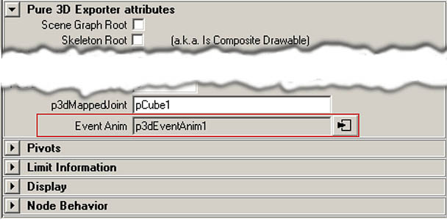


Collapsable Frames
Frame layouts are collapsable.

Slide 19
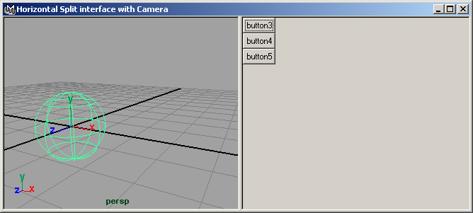
Pane Layout
One- or two-way draggable split bar.

Slide 20
Pane Layout (MEL)
// Pane Layout
window -title "Horizontal Split with Camera";
paneLayout -configuration "vertical2";
// left panel, camera view
modelEditor;
setParent ..;
//right panel, buttons
columnLayout;
button; button; button;
setParent ..;
showWindow;

Slide 21

Part Deux!
  User selection
  The ‘pickWalk’
  Return values
  Unique globals
  Commands to remember

Slide 22
MEL: Components
Components in regular selection result:
ls -sl;
pCubeShape1 pCube1.vtx[2] pCube1.f[1]
Isolating components:
filterExpand -sm 31;
pCube1.vtx[2]
Isolating objects:
selectedNodes;
|pCube1|pCubeShape1

Slide 23
MEL: pickWalk
ls -l -sl;
// Result: |group1|pCube1 //
pickWalk -d "down";
// Result: pCubeShape1 //
pickWalk -d "up";
// Result: pCube1 //
pickWalk -d "up";
// Result: group1 //
Modifies the active selection.
Also “right” and “left” flags

Slide 24
MEL: polyEvaluate
Useful for getting triangle count.
polyEvaluate -face hulk_body;
// Result: 1322 //
polyEvaluate -triangle hulk_body;
// Result: 2320 //

Slide 25
MEL: Using Return Values
Return type declared in procedure.
proc int myProcedure() {}
Use `` or () syntax to capture return value:
int $value1 = `myProcedure`;
int $value2 = myProcedure();
See “Procedure and function” and “Flow control” FAQs.

Slide 26
MEL: Build Your Own UI
UI names are global and must be unique!
Check if window UI exists, and rebuild if necessary:
string $windowUI = "myWindowUI";
if ( `window -exists $windowUI` )
deleteUI -window $windowUI;
window -title "My Window" $windowUI;
…

Slide 27
MEL: Unique Globals
UI names are global and must be unique!
Use a static prefix to provide a “namespace.”
string $namespace = "exporter_";
string $windowUI = ( $namespace + "myUI" );
string $buttonUI = ( $namespace + "button" );
window -title "My Window" $windowUI;
columnLayout;
button -label "Click Me" $buttonUI;
setParent ..;
showWindow $windowUI;

Slide 28
MEL: Commands To Remember
help
Shows arguments for built-in commands.
whatIs <command>
Tells where a MEL script lives.
exists <command>
Indicates if a MEL command exists.
objExists <object>
Indicates if a scene object exists.

Slide 29
Summary
A touch of MEL can take the drudgery out of many tasks.
Introduce loops, timing and subtle variations.
Use Maya’s online documentation.
Understanding where and how Maya converts MEL to bytecode removes the mystery when things don’t work.
Assign unique names to UI controls.

Slide 30
Comments?
Email:
Gene Endrody: gendrody@radical.ca
Bryan Ewert: bewert@radical.ca
Rustle Hill: rhill@radical.ca

